Slide 1
C H A P T E R 3
Operating Systems
(and Networks)
Using hardware directly is highly complicated
even at the machine language level
Especially so when multiple users want to perform multiple tasks - all at the same time
abstraction layer: Operating System
Prepared by Dr. Syed Khaldoon Khurshid

Slide 2
3.X: Computer System Overview
Internet
browser
Adventure
games
Airline
reservation
Application programs
Command
interpreter
Editors
Compilers
System programs
Operating system
Machine Language
Microprogramming
Hardware
Physical devices

Slide 3
3.X: What is an Operating System?
Top-down view: operating system is there to present the user with the equivalent of a ‘virtual machine’
hardware is difficult to program
user should not be annoyed with low level details
OS =>high-level abstractions (files, device access,.)
Bottom-up view: operating system is there to manage all the pieces of a complex system
orderly, controlled management of multiple programs running at the same time
if needed: orderly, controlled management of multiple users at the same time

Slide 4
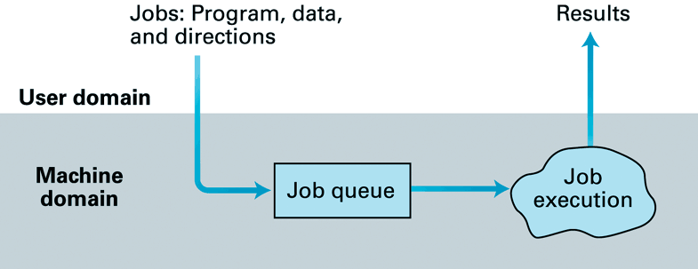
3.1: The Evolution of Operating Systems (1)
1945-1955:
User/programmer was ‘operating system’
1955-1965:
Human operator was ‘operating system’
Advent of ‘batch processing’:

Slide 5
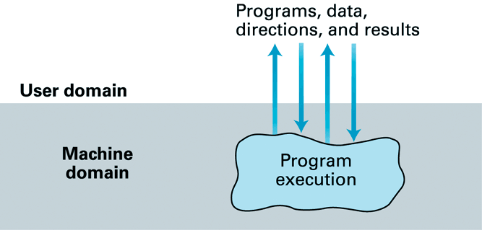
3.1: The Evolution of Operating Systems (2)
1965-1980:
Advent of ‘interactive processing’:
Provide services in a timely manner
‘real-time processing’
Multitasking (single-user) & time-sharing (multi-user)

Slide 6
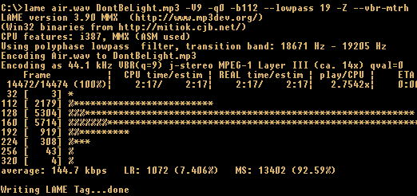
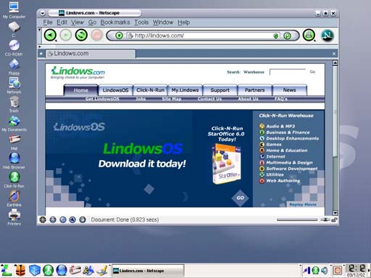
3.1: The Evolution of Operating Systems (3)
1980-now:
Operating systems for multi-processor architectures
includes: load balancing
Focus on user-friendliness:
especially: Graphical User Interface (GUI)
=>

Slide 7
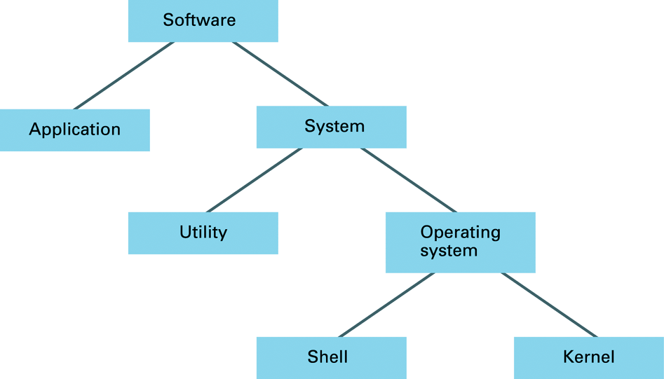
3.2: Software classification
distinction
is vague!
distinction
is vague!
Extends capabilities of the OS
Some of the examples of the
utility programs (Utilities) include:
Disk defragmenters, System Profilers, Network Managers, Application Launchers,
Antivirus software, Backup software, Disk repair, Disk Cleaners, Registry Cleaners,
Disk Space analyzer, file manager, File Compression, Data Security and many more

Slide 8
3.2: Components of an Operating System
Interface between the OS and users:
shell (command-line, or GUI incl. window manager)
Internal part of OS:
kernel :
file manager (coordinates the use of mass storage)
{Directory, folder, path and file descriptor}
memory manager (coordinates the use of main memory, especially in single-user or multi-user environments)
{Virtual Memory: Pages created and stored on Mass storage}
device drivers (for communication with external device controllers)
scheduler (coordinates the execution of multiple activities)
dispatcher (controls the allocation of time slices to activities)

Slide 9
3.3: The Concept of a Process (1)
Important is distinction between a ‘program’ and the ‘activity of executing a program’!
Program is a static set of directions
Activity is dynamic, and its properties may change over time => ‘process’
Process has state, including:
current position in program (value of the program counter)
values in general-purpose registers & memory cells
So: state is snapshot of machine at certain time

Slide 10
3.3: The Concept of a Process (2)
A single program may run multiple processes
Example: multi-user word-processing program
two users edit separate documents at same time
both use the same copy of the program in main memory, but each with its specific set of data & process states
In a computer system many processes compete for time slices
Coordination / administration of these is one of most important tasks of time-sharing OS…

Slide 11
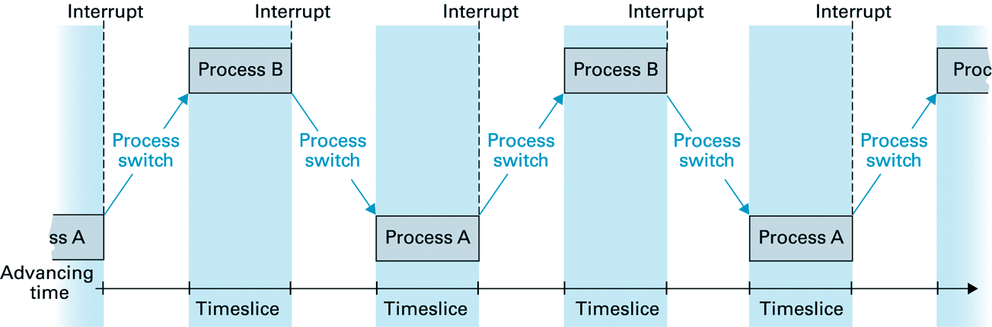
3.3: Process Administration & Time-sharing
Process administration handled by
(1) scheduler
keeps track of all processes by maintaining a process table
Entries like memory area and Priority (wait or ready)
(2) dispatcher
ensures that scheduled processes are executed by dividing time into slices/ quantum , and switching CPU’s attention among the processes
Interrupt handler

Slide 12
Process Administration
Coordination of Dispatcher and Scheduler : Adjusting to Priorities
Example:
I/O Request
Time Allocated Time expires
Ready Wait
Controller Task completed
Restore at the point of interrupt
Immediate Environment prior to interrupt-> Process States

Slide 13
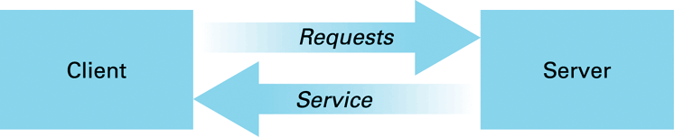
3.3: Interprocess Communication
Various units within an OS also execute as processes
To coordinate their activities, these processes must communicate with each other
Interprocess communication
One form of Interprocess communication:
client/server model (also used in computer networks)
example: file-server providing access to files on request

Slide 14
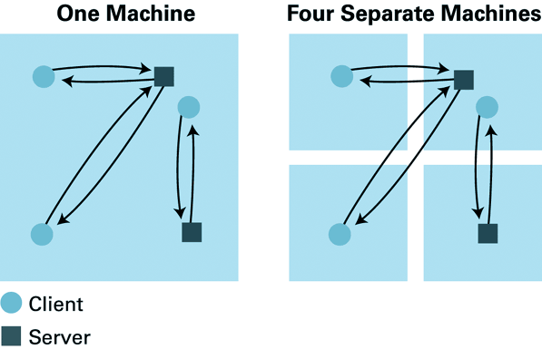
3.3: The Client/Server Model
Client and Servers are softwares within a machine or among different machines
The role of the server is the same whether the client resides on the same machine or on a distant machine!
Difference only in the communication software, not in the clients and servers
CORBA(Common Object Request Broker Architecture): standard for network wide communication between softwares units known as objects (such as clients and servers)

Slide 15

3.4: Handling Competition Among Processes
Process
A
?
Process
B
Use flag?
Yes: I’m free!
No: I’m busy!

Slide 16
3.4: Problems…!
Ah, it’s free
Process
A
Process
B
Yes: I’m free!
No: I’m busy!
two processes
are now using
the printer at
the same time!
the problem is
that flag-testing
and -setting should
not be interrupted!

Slide 17
3.4: Solutions...
One possibility is to use interrupt enable and interrupt disable instructions
disadvantage: process may remove the possibility of being interrupted altogether
Other approach is to use single test-and-set instruction
always completed before an interrupt can be handled
flag implemented this way is a.k.a.: semaphore
Critical Region
A sequence of instructions executed by only one process at a time
Mutual Exclusion: A requirement

Slide 18
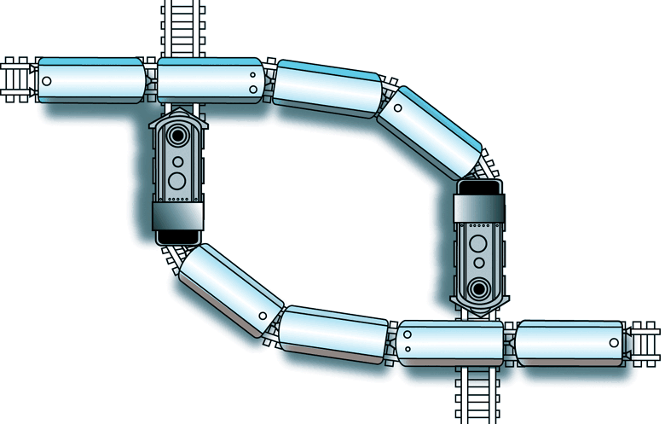
3.4: Another problem: Deadlock
Two or more processes are blocked because each is waiting for access to resources allocated to another
task 1: printer yes, disk drive no
task 2: printer no, disk drive yes
Three must conditions for deadlock:
There is competition for non shareable resources.
The resources are requested on partial basis; process returning back for more resources.
3) Once a resource has been allocated, it cannot be forcibly retrieved.

Slide 19
Solutions:
Deadlock detection and correction
by forcibly retrieving some allocated resources
Example: Process Kill
Deadlock avoidance
spooling (make the resource appear as if it can be shared by multiple processes at same time)
Example: Printer Spooling
Other Problems
File access: read and write

Slide 20
Chapter 3 - Operating Systems: Conclusions
Operating System - ‘glue’ between hardware and applications
Manages and controls multiple applications running at same time
May also service multiple users at same time
Multi-tasking / time-sharing based on processes
Difficulties arise due to competition among multiple processes and deadlocks

